Slide 1
CMP202 Assessment
By Fraser Barker(1600196)

Slide 2
Topic
Interactive Mandelbrot
Parallelised using GPU
Lab exercise used as a basis
External Libraries
OpenGL (Year 2, Semester 1 base project file)

Slide 3
Purpose
Interactive Mandelbrot via OpenGL
Demonstrate good GPU parallelisable algorithm.

Slide 4
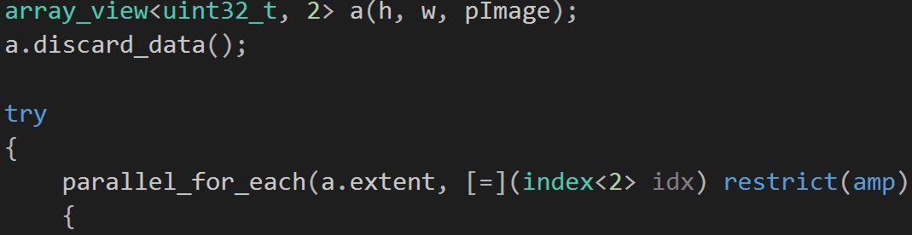
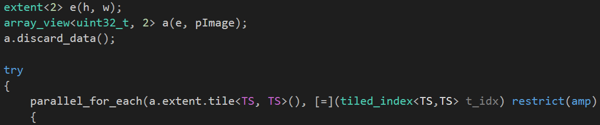
Parallel construction
Pipeline pattern
Single CPU Thread (Host)
SIMD (Device)
OpenGL calls (Kernel)
Mutexes?

Slide 5
Thread utilisation
Single CPU Thread (Host)
Non-tiled GPU kernel vs Tiled GPU kernel
Mandelbrot – Data independent
Multi GPU (future)

Slide 6
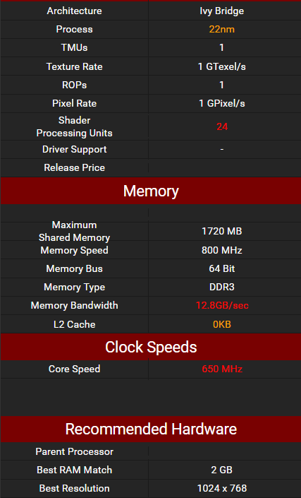
Specification
4506 Lab Computers
OS – Windows 7 Professional
GPU – Intel® HD Graphics 2500
CPU – Intel® Core™ i5-3470S @ 2.90GHz
RAM – 4GB

Slide 7
Results
Time taken to compute Mandelbrot at various levels. (Iterations, Width/Height) (ms)
1000 x (500,2500,5000 Max_Iters) @ 640x480
1000 x (500,2500,5000 Max_Iters) @ 960x768
1000 x (500,2500,5000 Max_Iters) @ 1280x960
1000 x (500,2500,5000 Max_Iters) @ 1920x1280
Eliminate sources of error

Slide 8
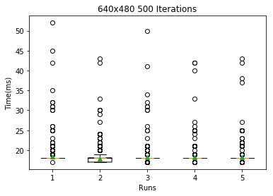
Results – 640x480 – 500 Iterations
Tile Size | Mean(ms) | Median(ms)
Not tiled | 18.4105894106 | 18.0
4 | 17.8291708292 | 18.0
8 | 18.1508491508 | 18.0
16 | 18.2137862138 | 18.0
32 | 18.2157842158 | 18.0

Slide 9
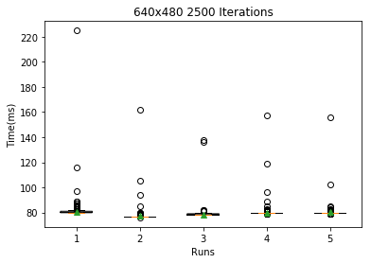
Results – 640x480 – 2500 ITERATIONS
Tile Size | Mean(ms) | Median(ms)
Not tiled | 80.6573426573 | 80.0
4 | 77.2767232767 | 77.0
8 | 78.4095904096 | 78.0
16 | 80.0799200799 | 80.0
32 | 80.1378621379 | 80.0

Slide 10
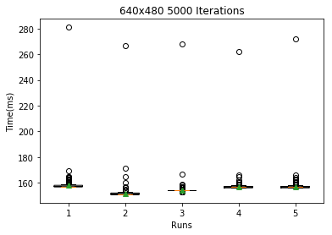
Results – 640x480 – 5000 ITERATIONS
Tile Size | Mean(ms) | Median(ms)
Not tiled | 157.963036963 | 157.0
4 | 151.51048951 | 151.0
8 | 154.268731269 | 154.0
16 | 156.754245754 | 157.0
32 | 156.92007992 | 157.0

Slide 11
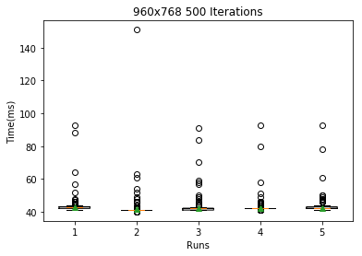
Results – 960x768 – 500 ITERATIONS
Tile Size | Mean | Median
Not tiled | 42.6983016983 | 43.0
4 | 41.4445554446 | 41.0
8 | 41.9380619381 | 42.0
16 | 42.2747252747 | 42.0
32 | 42.4185814186 | 42.0

Slide 12
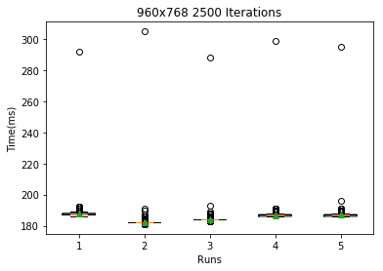
Results – 960x768 – 2500 ITERATIONS
Tile Size | Mean | Median
Not tiled | 187.566433566 | 187.0
4 | 182.123876124 | 182.0
8 | 184.236763237 | 184.0
16 | 186.776223776 | 187.0
32 | 186.97002997 | 187.0

Slide 13
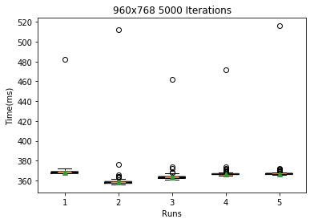
Results – 960x768 – 5000 ITERATIONS
Tile Size | Mean(ms) | Median(ms)
Not tiled | 368.331668332 | 368.0
4 | 358.282717283 | 358.0
8 | 362.982017982 | 363.0
16 | 366.833166833 | 366.0
32 | 366.839160839 | 367.0

Slide 14
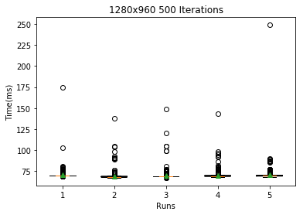
Results – 1280x960 – 500 ITERATIONS
Tile Size | Mean(ms) | Median(ms)
Not tiled | 70.2417582418 | 70.0
4 | 68.8521478521 | 68.0
8 | 69.4185814186 | 69.0
16 | 69.8181818182 | 69.0
32 | 70.2057942058 | 70.0

Slide 15
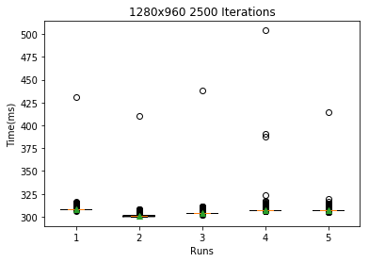
Results – 1280x960 – 2500 ITERATIONS
Tile Size | Mean(ms) | Median(ms)
Not tiled | 308.418581419 | 308.0
4 | 301.057942058 | 301.0
8 | 304.186813187 | 304.0
16 | 307.411588412 | 307.0
32 | 307.253746254 | 307.0

Slide 16
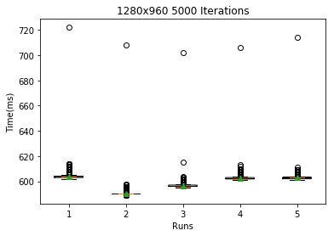
Results – 1280x960 – 5000 ITERATIONS
Tile Size | Mean(ms) | Median(ms)
Not tiled | 603.978021978 | 604.0
4 | 590.294705295 | 590.0
8 | 596.665334665 | 596.0
16 | 602.69030969 | 602.0
32 | 602.886113886 | 603.0

Slide 17
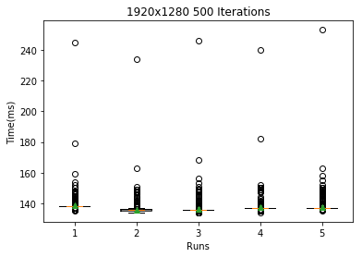
Results – 1920x1280 – 500 ITERATIONS
Tile Size | Mean(ms) | Median(ms)
Not tiled | 138.552447552 | 138.0
4 | 136.03996004 | 136.0
8 | 136.529470529 | 136.0
16 | 137.585414585 | 137.0
32 | 137.517482517 | 137.0

Slide 18
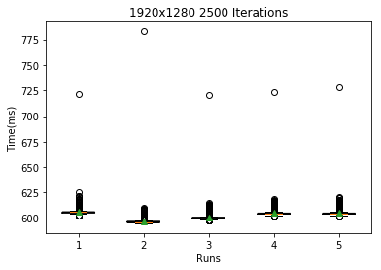
Results – 1920x1280 – 2500 ITERATIONS
Tile Size | Mean(ms) | Median(ms)
Not tiled | 606.14985015 | 606.0
4 | 596.944055944 | 596.0
8 | 600.948051948 | 600.0
16 | 605.020979021 | 604.0
32 | 604.929070929 | 604.0

Slide 19
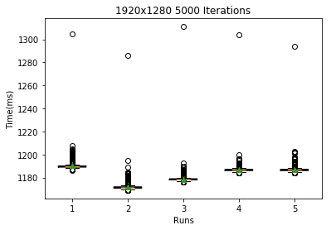
Results – 1920x1280 – 5000 ITERATIONS
Tile Size | Mean(ms) | Median(ms)
Not tiled | 1190.27072927 | 1190.0
4 | 1171.91808192 | 1171.0
8 | 1178.58941059 | 1178.0
16 | 1187.05394605 | 1187.0
32 | 1187.07992008 | 1187.0

Slide 20
Explanation
An explanation of these results in terms of the design of your application and your understanding of processor and memory architecture (i.e a description of why it performs the way it does) on the CPU or GPU.
Tiled vs Non-Tiled?
Memory Access patterns?
Shared Memory
32 Threads

Slide 21
Key results
Presentation of key results of the performance evaluation
TS 4 – 8 Best, Possible 12 being sweet spot.
Rank Sum, Confidence Intervals, T-Test

Slide 22
Critical evaluation
A critical evaluation of the effectiveness of your solution, with reference to your performance evaluation.

Slide 23
Technical choices
You must explicitly justify your technical choices, and quantify their effect during performance evaluation, using the knowledge you’ve gained from undertaking the module.

Slide 24
Resources
SciPy – Statistics calculations, graphical representations.
Adam Sampson/Ruth Falconer – Lab project which this submission is based off of.
Paul Robertson – OpenGL base project

